Slide 1
Lab 7

Slide 2
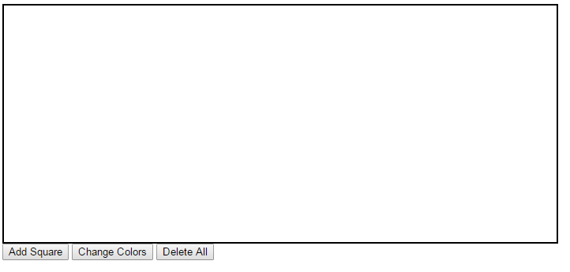
Lab 7
Write a HTML document with JavaScript code to randomly generate a square in a random color. The initial page looks like below

Slide 3
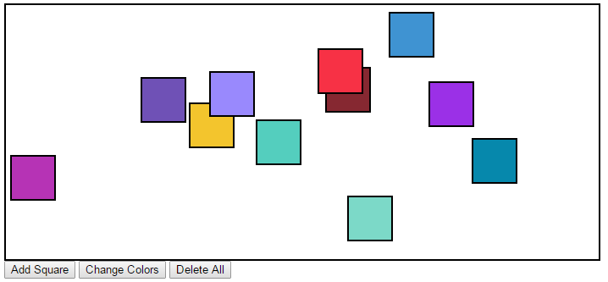
Lab 7
User can click on “Add Square” to add a square at a random position within the box in a random color

Slide 4
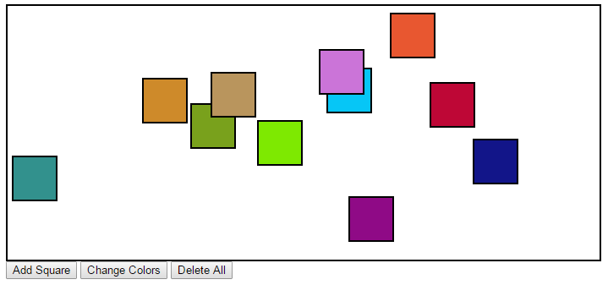
Lab 7
User can click on “Change Colors” to change all the colors to random colors

Slide 5
Lab 7
User can click on “Delete All” to delete all the squares

Slide 6
Requirement
In a separate CSS file, specify the properties of the outer box (id) and the inner random squares (class)

Slide 7
Requirement
Implement three JavaScript functions corresponding to the three buttons
addSquare(): create and add a new square div element to the page by using document.createElement()
Use .className property to specify its class name
Use .style.left and .style.top to specify its location Use appendChild to add the element into the box

Slide 8
Requirement
changeColors(): give a new randomly chosen color to every square in the box.
Use document.querySelectorAll() to select all the squares
deleteAll(): delete all the squares in the box. You can assign an empty string to the element’s innerHTML

Slide 9
Requirement
Also, implement an auxiliary function which is called by addSquare() and changeColors()
getRandomColor(): generate and return a random color string

